Slide 1
ENSE 400 Mentor Scrum Report-Out
Westside Boys
Daris Lychuk & Kegan Lavoy
November 22nd, 2019

Slide 2

Project deats
What problem(s) are you trying to solve?
Make finding the best insurance & medication easy and fast for people without benefits
What gap are you filling?
Comparison between multiple insurance providers
What innovation are you creating?
Web application that auto compares insurance providers based on user input
Notes:
30 seconds

Slide 3

Project & documentation review
“Show me what you got”
Project Vision: Make finding the best insurance smooth and easy for all types of people
Rationale: Currently quite difficult to even get a quote, even more so to compare between providers
Stakeholders: Insurance providers (URSU so far), people without coverage, government (if their plan is one we use)
Constraints: Insurance companies may have private price calculations, may not want to join at all
Notes:
1-2 minutes

Slide 4
Project & documentation review
What have we worked on?
USM
Github as source control software
Personas
Reviewing information sent by URSU
Functional Requirements Doc
Lo-Fi prototyping in Adobe XD
Notes:
We will be using vue.js & node.js with MongoDB to store our data.
Most likely using AWS when the time comes.
https://landofooo.storiesonboard.com/m/westside-boys

Slide 5
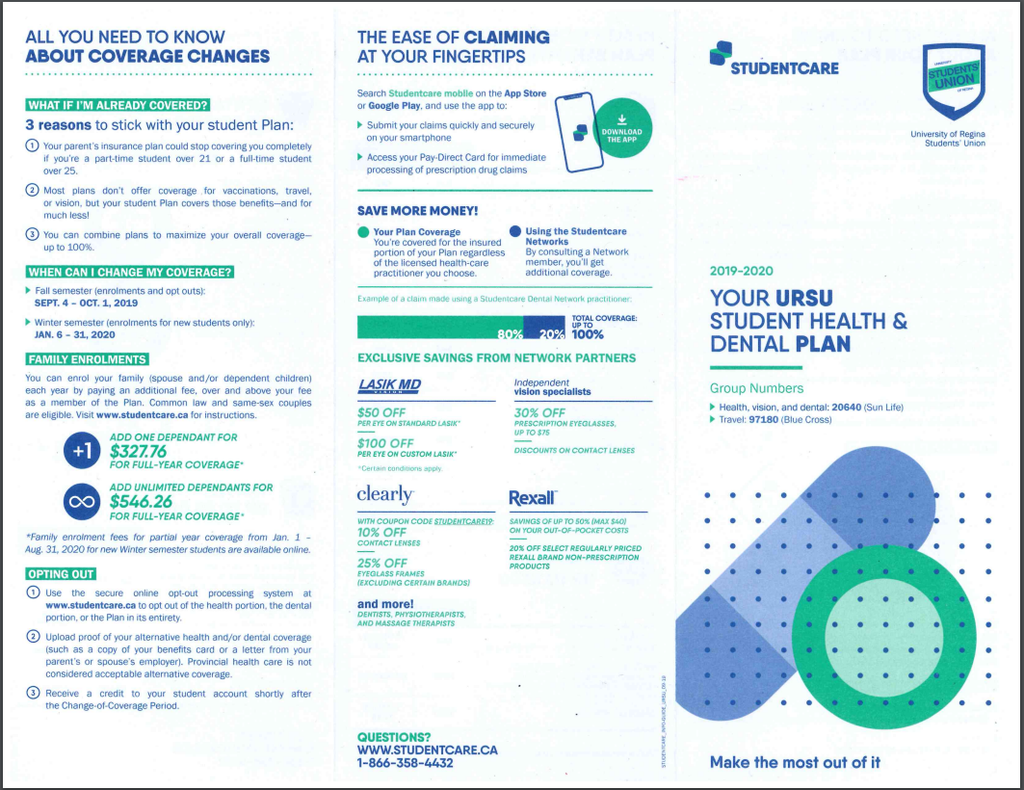
Notes:
Quick view

Slide 6

Notes:
Quick view

Slide 7
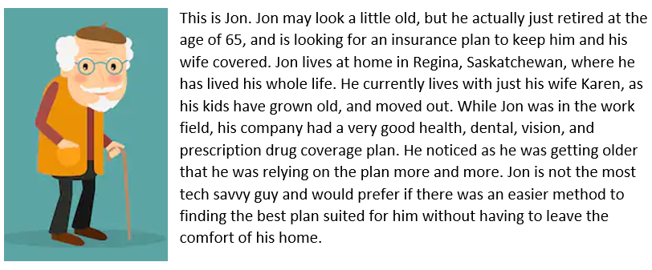
Persona #1
Notes:
Quick view

Slide 8
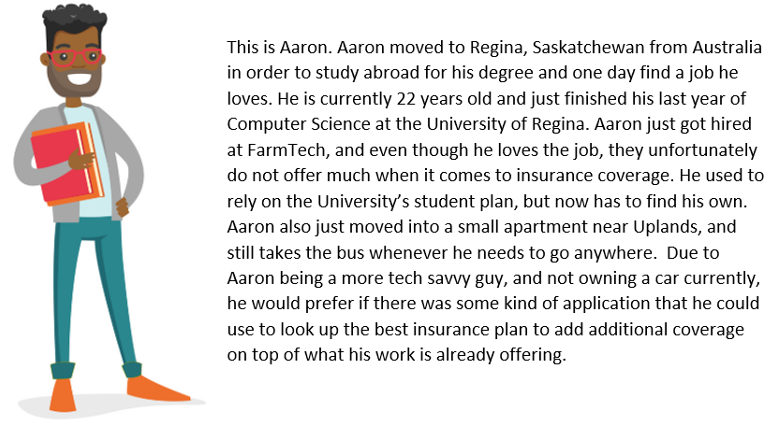
Persona #2
Notes:
Quick view

Slide 9
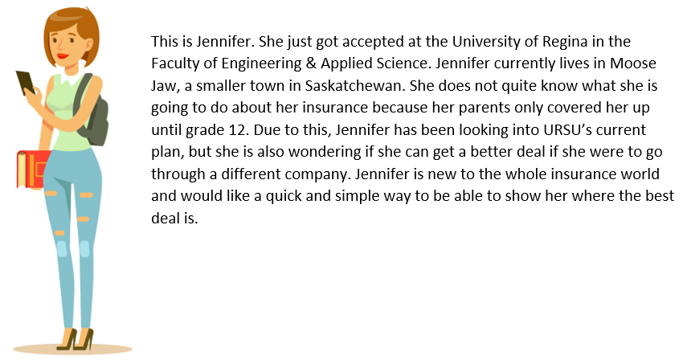
Persona #3
Notes:
Quick view

Slide 10
Lo-Fi Prototype Demo

Slide 11

Group reflection
Do you feel you are on track?
We feel like we are. We have some data from URSU and Blue Cross website for starters
Fairly busy this semester but should be better next semester
Do you feel there are barriers to your success (if any)?
Getting more insurance companies on board
Importing their data if they do come on board
Getting approximate estimates on pricing from other companies.
No current API’s for Canadian insurance companies
Notes:
30 seconds

Slide 12

Mentor Q/A
Notes:
Tim’s notes: You’ve used up around 3 and, hopefully not 4 minutes. You should try your best to ensure at least 3 minutes for Q/A. More minutes, seconds is even better. The bonus is I won’t ask anything as we’ve been meeting lots. Try your best to keep in time. Be prepared to present when called. Good luck (and hopefully mentors aren’t like Confucius over there!!! ☺)

Slide 13
Image refs
Show me what you got, https://pictures.abebooks.com/isbn/9781548899530-us-300.jpg
Patrick, https://imgflip.com/memetemplate/43274976/spongebob-patrick-nail-saw
Pondering, https://imgflip.com/s/meme/Question-Rage-Face.jpg
Question, https://www.gettingsmart.com/wp-content/uploads/2015/07/question-mark-483x335.jpg

